Slide 1
Related & Related table
Related & Related table

Slide 2
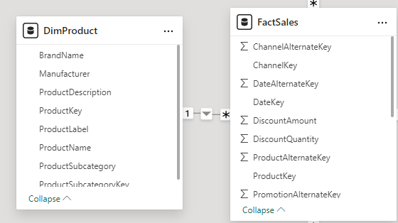
Related & Related Table
Note: This demo uses the DimProduct and FactSales tables from Sales201823.xls .
Note that the relationship between DimProduct and FactSales is one-to-many.

Slide 3
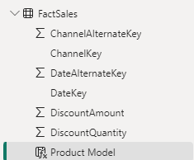
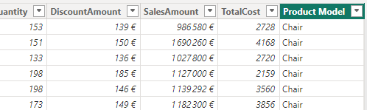
Related & Related Table
Add a new calculated column added to the FactSales table called "Product Model" .
Product Model= RELATED ( DimProduct [ BrandName ] )
"Product Model" column must be located at the FactSales table level .

Slide 4
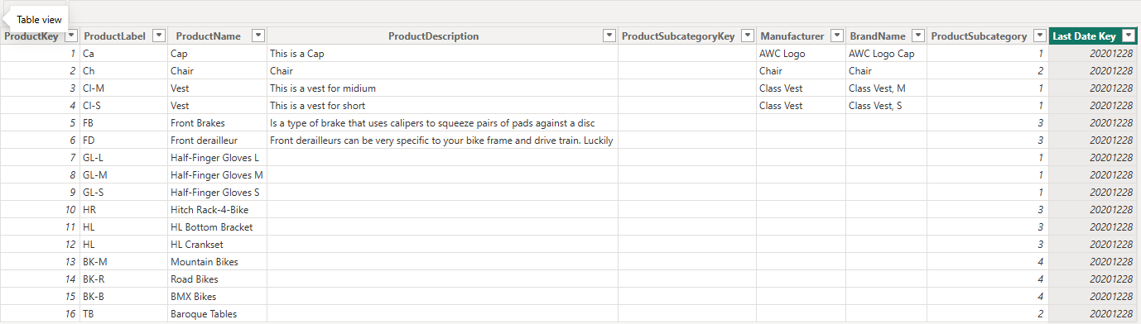
Related & Related Table
Now we consider to represent of the product's last date key at the column level.
Create a column named "Last Date Key" which represents the last date key.
Last Date Key = MAXX ( RELATEDTABLE ( FactSales ), MAX ( FactSales [DateKey ]))
Note that a column has been added to the column collection called "Last Date Key" , which contains values corresponding to the last boarding date.

Slide 5
Thank you
Thank you

